Slide 1
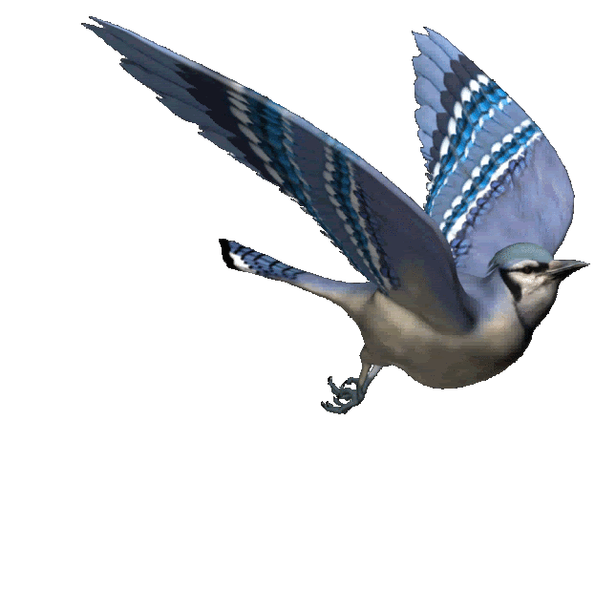
Look at the pictures and try to understand
The bird will be flying in the sky.

Slide 2
Future continuous Tense
Learning outcomes;
The students will have ;
*learnt what future continuous tense is.
*learnt the structure of future continuous tense.
*learnt the uses of future continuous tense.

Slide 3
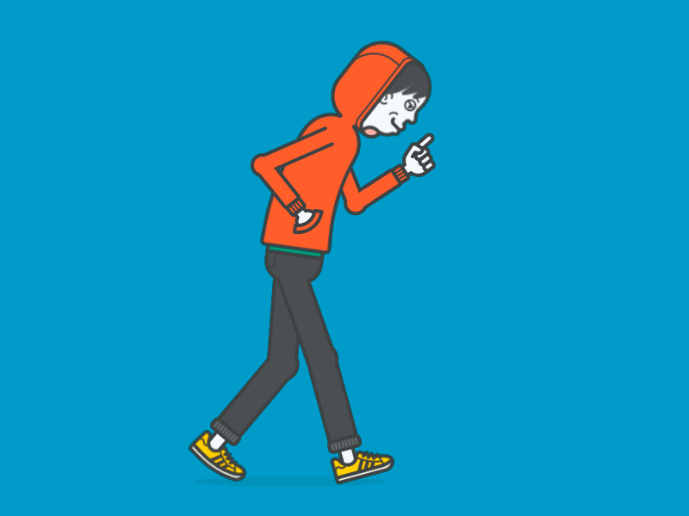
The boy will be walking on the road

Slide 4
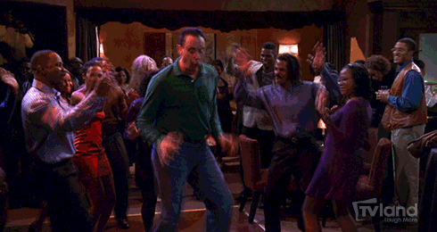
They will be dancing in the hallroom

Slide 5
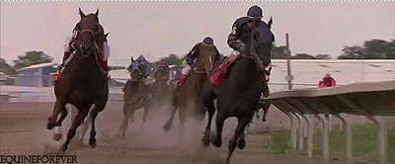
The horses will be running fast

Slide 6
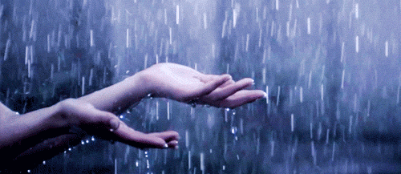
It will be raining heavily tomorrow.

Slide 7
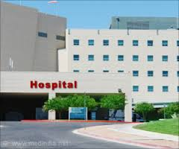
I shall be going to the hospital tomorrow.

Slide 8
The red roses will be blooming

Slide 9
Future continuous tense;
It denotes an action that will be going on in
Future.
STRUCTURE
*Subj+shall be/wil be(AV)+PV(present form)+ing+Obj/OE.

Slide 10
EVALUATION
Fill in the blanks with the right form of the verbs in the future continuous tense;
1.Mother------the holy Quran every morning.(read)
2.I---------the sum tomorrow.(do)
3.The dog---------(bark)
4.The students ----------to school.(go)
5.The farmer---------paddy the next day.(cut)

Slide 11
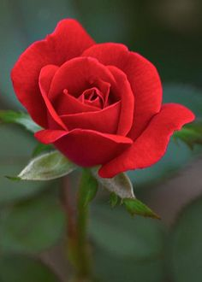
HOME WORK
Write five sentences about yourself by using future continuous tense.
Thank you

